Slide 1
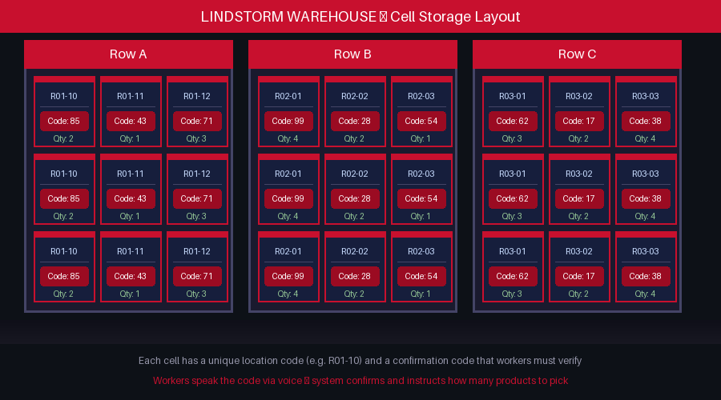
LINDSTORM WAREHOUSE SYSTEMS
Voice-Enabled
Picking Assistant
Hands-free | Voice-guided | Real-time supervisor tracking
Presented by: Sagar Kandel | ICT Project Presentation | 2025

Slide 2
PROJECT OVERVIEW
02
THE PROBLEM
Workers carry paper lists — slow and error-prone
Wrong cell location causes costly picking mistakes
Both hands occupied — cannot type or check phone easily
Supervisors have no live view of task progress
OUR SOLUTION
Voice assistant speaks location automatically on login
Worker speaks confirmation code — completely hands-free
System announces: 'Pick 2 products from R01-10'
Say 'Done' — next task loads and announces itself
Warehouse cell layout — each cell has a location code and confirmation code

Slide 3
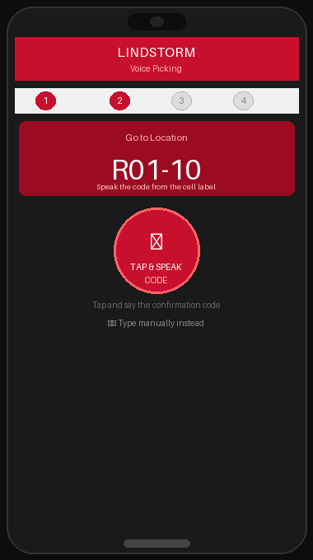
HOW IT WORKS
03
Complete hands-free picking workflow — from login to task complete
1
Login
Go to http://localhost:5000 • Login: worker1 / worker123
Open browser on phone
2
Voice Speaks
'Go to location R01-10' • 'Speak the confirmation code'
App says automatically:
3
Speak the Code
Say code shown on cell label • System verifies voice input
Tap big microphone button
4
Pick Products
'Pick 2 products from R01-10' • Collect the items from shelf
App announces loudly:
5
Say Done
Task marked as complete • Next location loads & speaks
Tap mic, say 'Done'
App on worker's phone

Slide 4
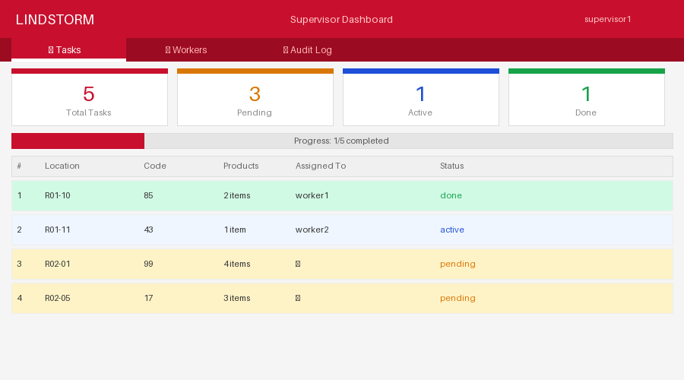
TECHNOLOGY & SUPERVISOR DASHBOARD
04
Python + Flask
API backend & web frontend
SQLite Database
Tasks, users & audit logs
Web Speech API
Voice input & output in Chrome
Waitress Server
Production-grade WSGI server
Supervisor dashboard — live task progress & worker performance
Key Features
Auto voice on page load
Multi-worker support
Priority task system
CSRF security
Full audit logging
Mobile browser ready
Python
Flask
SQLite
Voice API
CSRF Secure
Mobile Ready
Multi-Worker

